Slide 1
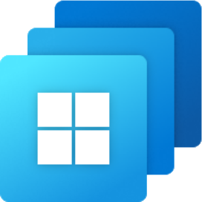
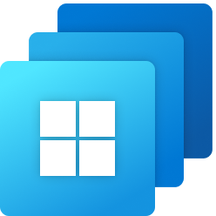
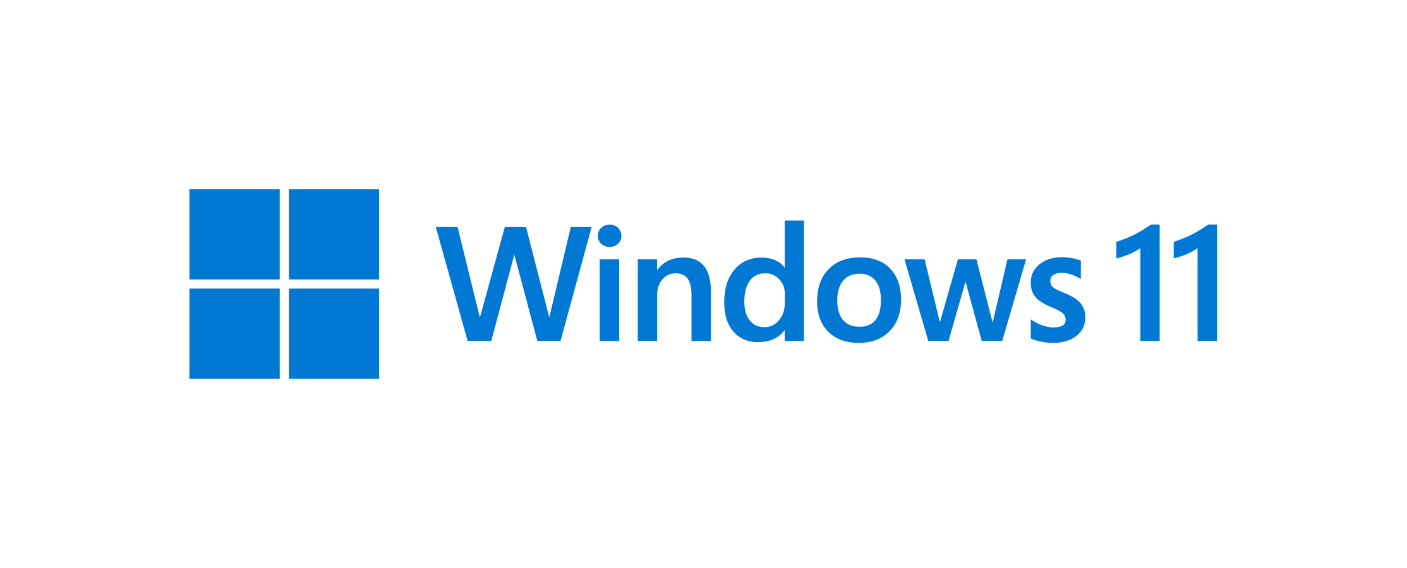
Microsoft-hosted network - Cloud PC’s Azure virtual network that’s fully managed by Microsoft
Microsoft Entra join
Microsoft Intune
Microsoft Entra ID
Customer subscriptions
VPN or private access
(Optional)
Customer corporate network
Virtual network
Windows 365 app
Azure subscriptions
Direct internet traffic
(Optional routing path)
Windows 365 gallery images

