Slide 1
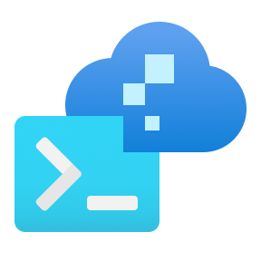
























Azure Virtual Desktop on Azure Local reference architecture
Control plane
Azure portal, ARM and Bicep templates, Azure CLI and tools
Microsoft
Entra ID
User authentication and token exchange during sign in
Azure Virtual Desktop
Azure Site Recovery
Azure Backup
Azure File Sync
Azure Update Manager
Other Azure services integration via Azure Arc
2
Azure Policy
Azure Monitor
Azure Key Vault
Microsoft Defender for Cloud
Hybrid identity synchronization between on-premises AD DS and cloud-based Microsoft Entra ID for local authentication and cloud access
Session initiation to Virtual Desktop in Azure from user’s device
3
User devices
4
Azure Virtual Desktop client
Azure Virtual Desktop agent connects to Azure, handling session brokering, user sessions, metering, and diagnostics
1
Active Directory Domain Services
Azure Arc agent integration for extra governance, monitoring, and lifecycle management
RDP Shortpath (with VPN) or direct UDP connection
User credential validation, group policy application
Azure Arc VMs
Azure Virtual Desktop (session hosts)
User profile storage location:
Dedicated NAS or SMB file share storage (preferred option)
OR
S2D pool on Azure Local instance
Azure Virtual Desktop agent
Azure Arc agent
NAS OR SMB file share
Azure Local instance
5
User profiles
Azure Local version releases
Hyper-V
Azure Arc
Resource Bridge
Storage Spaces Direct (S2D)
User profiles

Slide 2

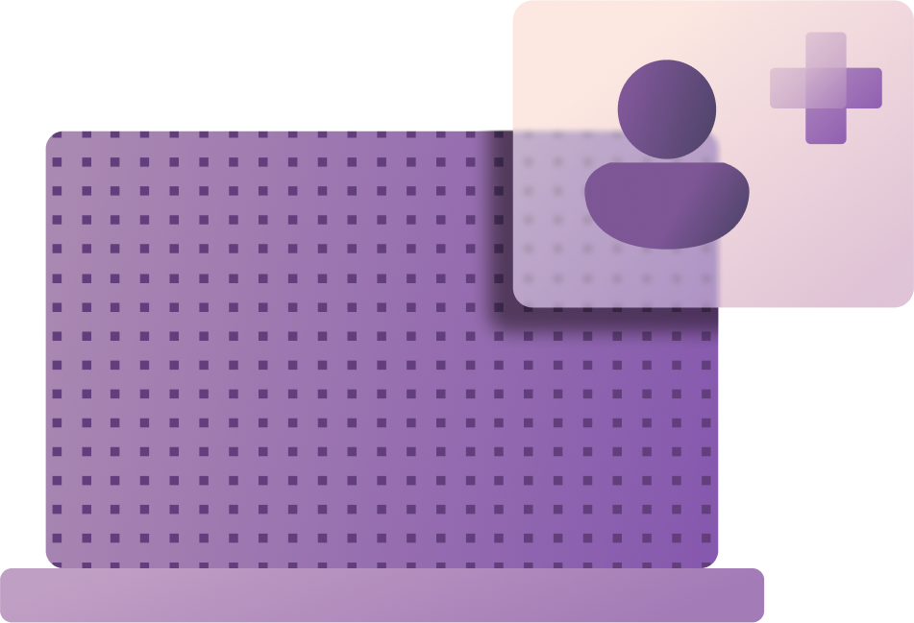
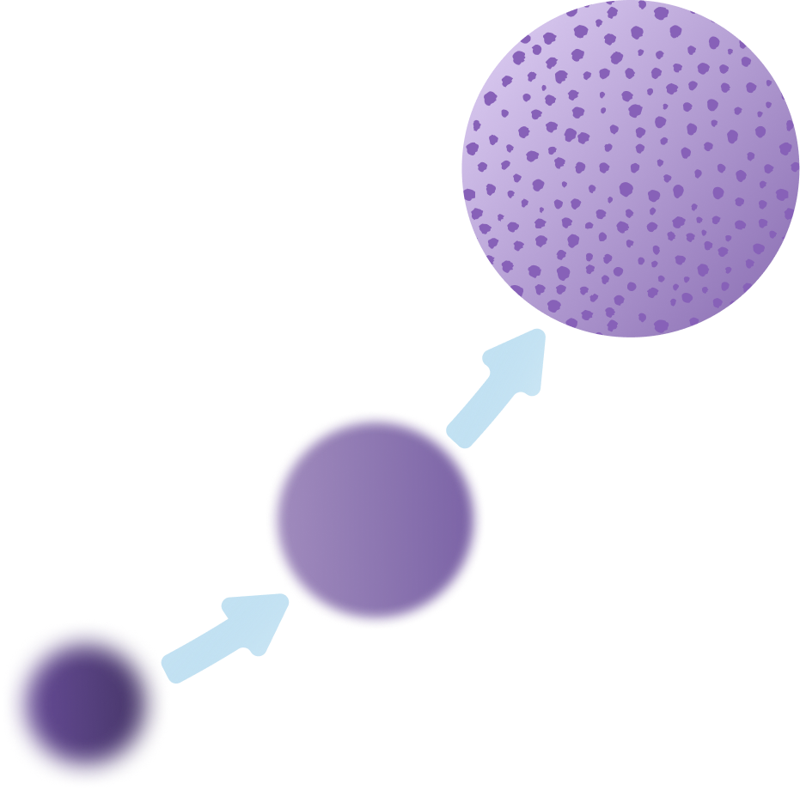

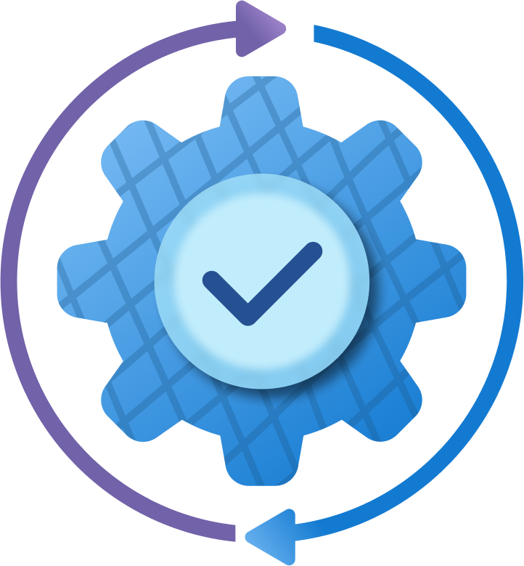
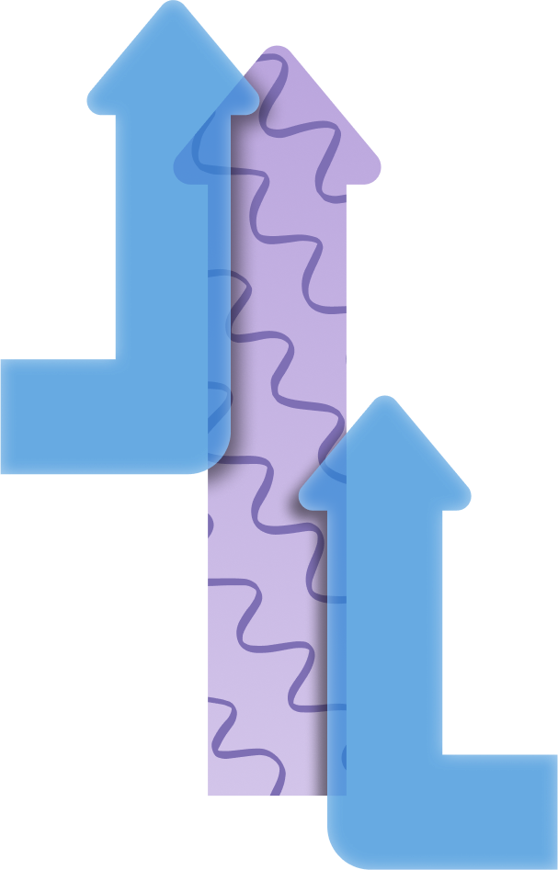
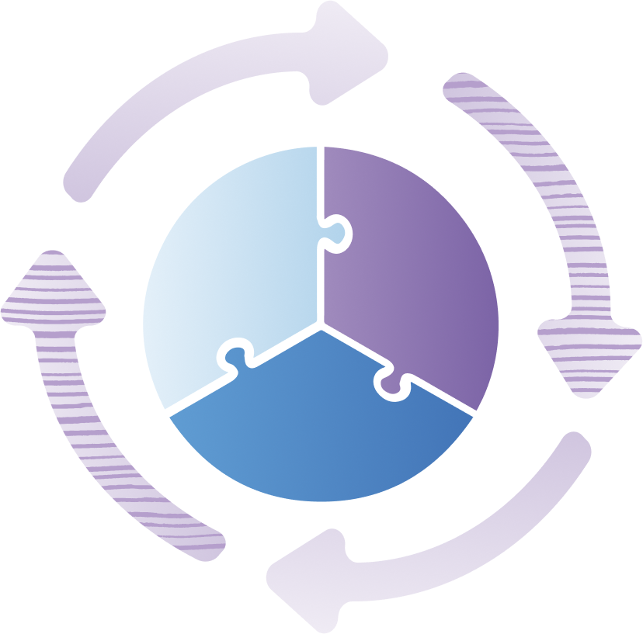



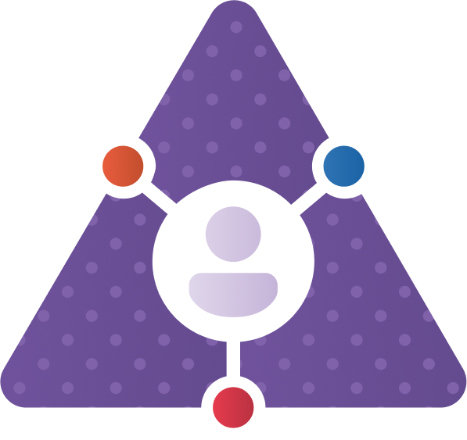
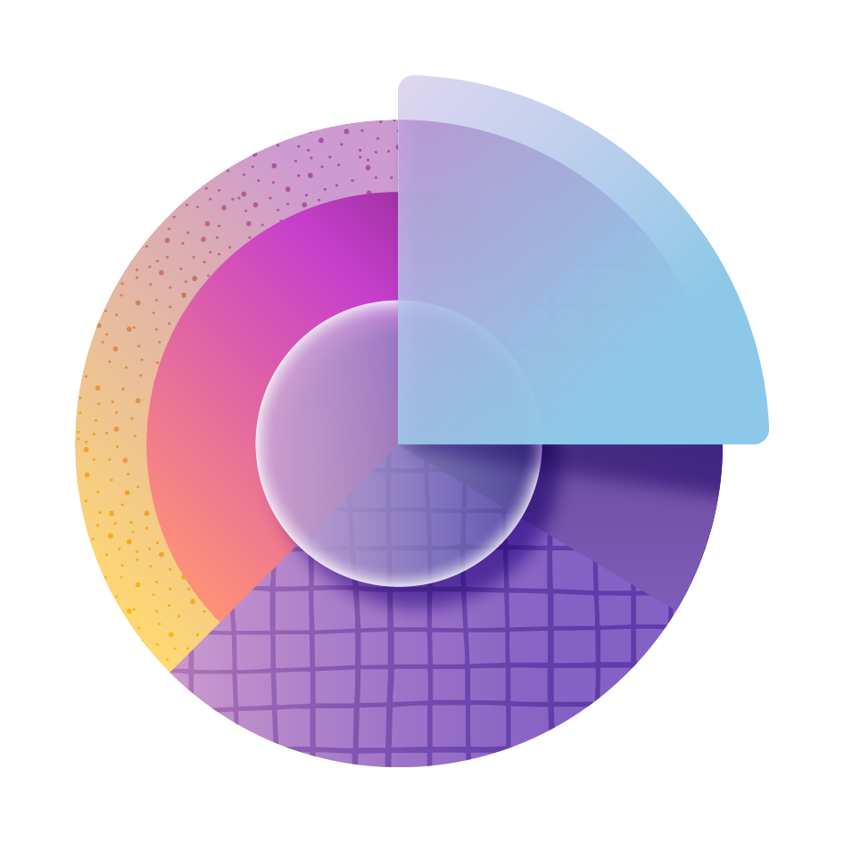


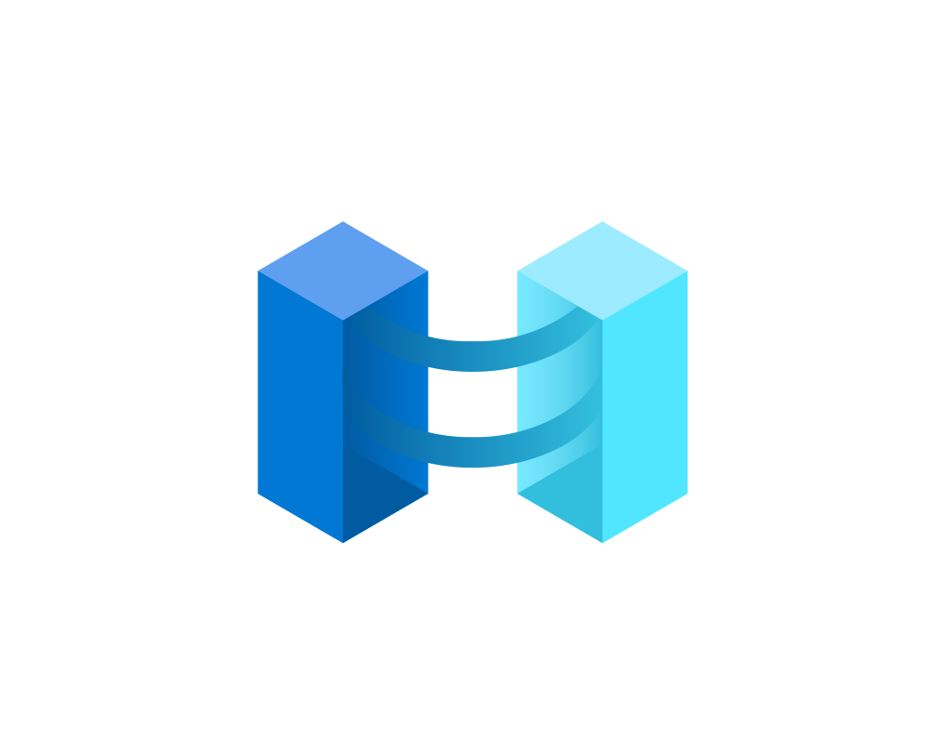

End user
Azure Virtual Desktop service managed by Microsoft
Web access | Diagnostics | Gateway | Management | Broker | Load balancing
Microsoft Entra ID
Your subscription - your control
Windows 11 Enterprise/ Windows 10 Enterprise | Windows Server 2016 and newer | Windows 11 Enterprise/ Windows 10 Enterprise multi-session | Remote app
Microsoft Office
Microsoft Teams
ExpressRoute
Managed by Microsoft (Azure hosted)
Managed by customer (Azure Local)
Compute | Storage | Networking
Compute | Storage | Software-defined networking
+ Azure Arc
Azure Local instance
Microsoft Azure
Each host pool must only contain session hosts on Azure OR the Azure Local instance

