Slide 1
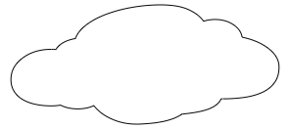


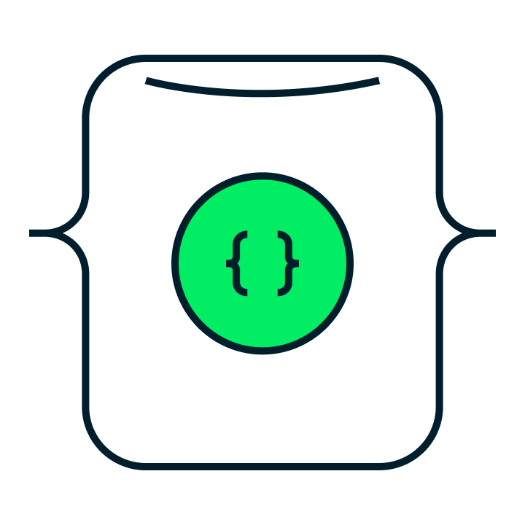




Mirrored MongoDB database
Insert, update, and delete
Default semantic model
MongoDB Atlas
SQL analytics endpoint
Near real-time incremental replication
OneLake (Delta or Parquet)

Slide 2
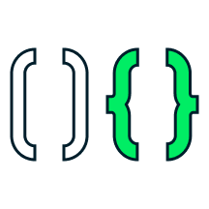

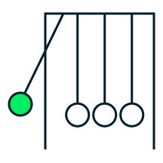
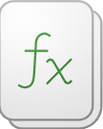
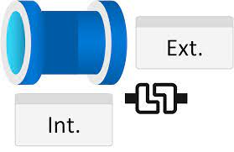

1
2
3
4
5
Cluster
Trigger
Function
Fabric functions
OneLake
MongoDB Atlas
Microsoft Fabric

Slide 3


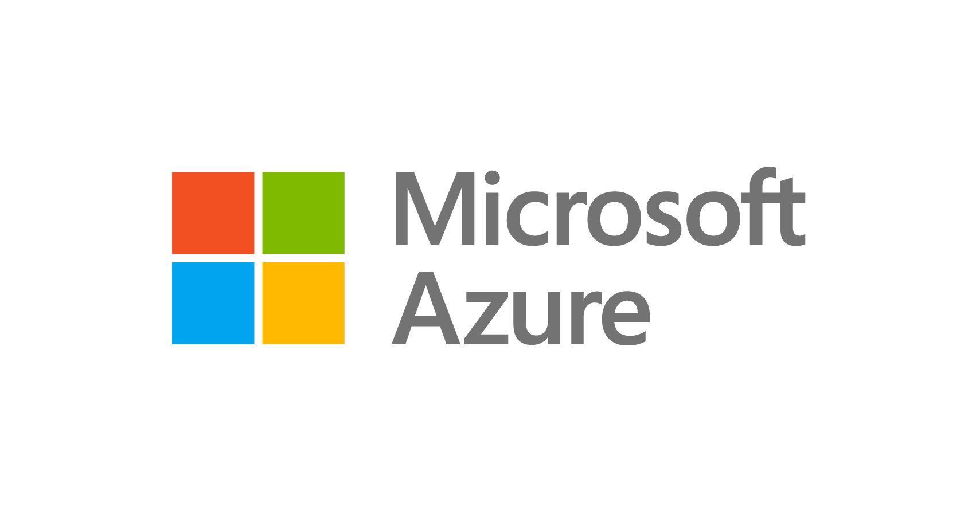
RDBMS
(tabular)
Enterprise data warehouse
Consumers
- Document data model
- Distributed systems architecture
- Cloud or on-premises
1
MongoDB Atlas on Azure
Consuming operational
apps and services
Machine learning
- Internal apps
- Customer-facing services
- APIs for non-Microsoft consumption across any channel
Big data analytics
MongoDB source connector
MongoDB
sink connector
MongoDB analytics
store
SQL
BI dashboard
Operational data
layer
Fabric
Logs
(unstructured)

Slide 4
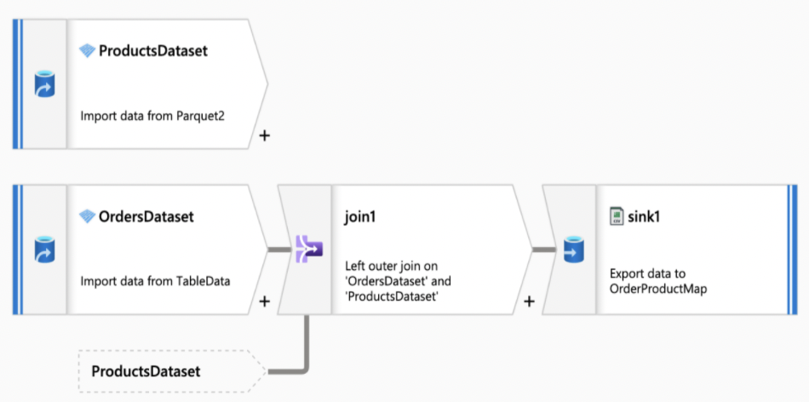
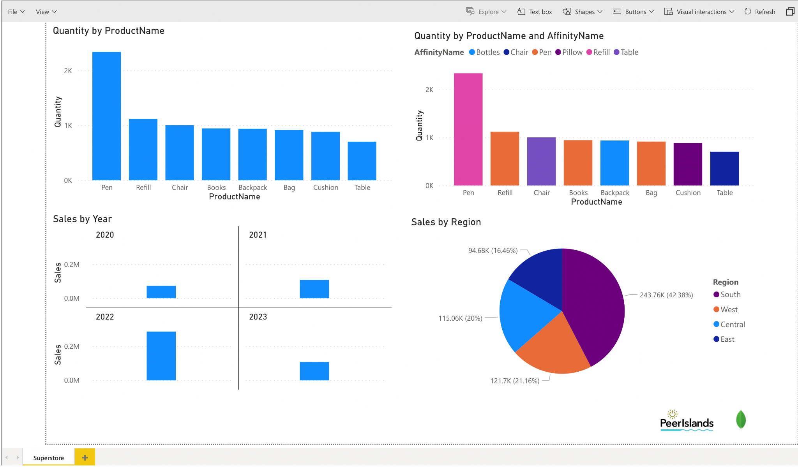
Fabric pipeline
Power BI analytics and dashboard

Slide 5
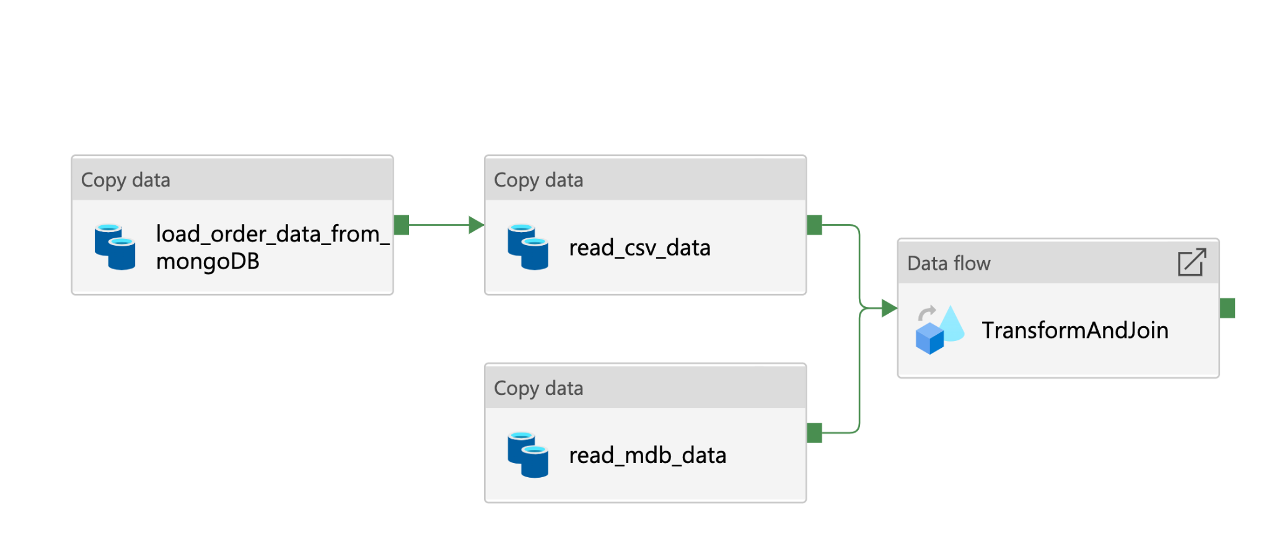
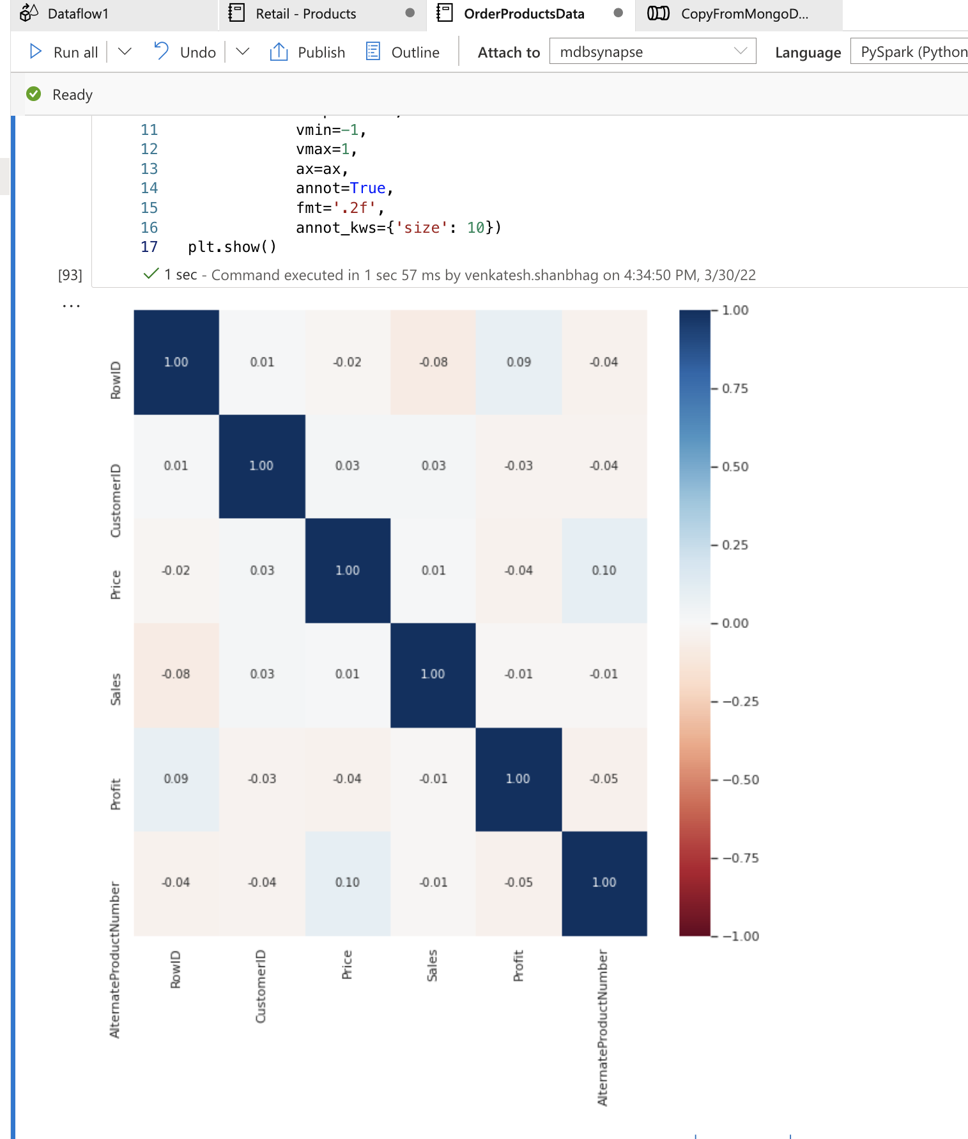
Fabric pipeline
PyCharm workflow

