Slide 1
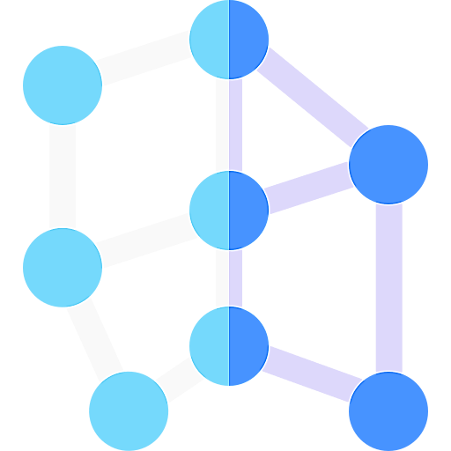
Intention recognition
Knowledge base database
CLU engine
Domain-specific
algorithm
Page ranking
Azure OpenAI Service
User input
Document filtering
Azure Cognitive Services
Document search
Text extraction
Summarizer

