Slide 1
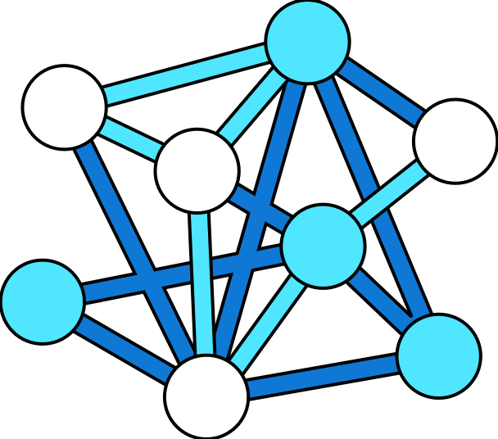
Predict length of stay
Health Data
Data Layer
Machine Learning Prediction
Analysis & Insight
EHR, EMR
(for predicting length of stay)
Hospital resource utilization data
(for bed occupancy, number of bed, doctor, nurse availability, etc )
1
Azure Data Factory
3
4
5
6
2
Care line manager /
Hospital resource coordinator
Azure Machine Learning
Azure Synapse Analytics
Power BI
Azure Data Lake Storage Gen2
Azure Machine Learning life cycle
Patient and patient’s family
Train
Validate
Deploy
Monitor
3.1
3.2
3.3
3.4

