Slide 1

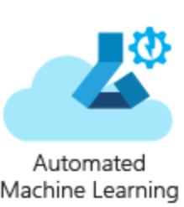







Use Case Architecture
3. Citizen Data Scientist
5. ML Ops
Good model?
1. Data Engineer
Yes
No
No
Data
Feature Engineering
Data
Standardization
Good model?
2. Data Scientist
Model
Prediction
Model
Revision
Yes
4. BI Analyst

