Slide 1
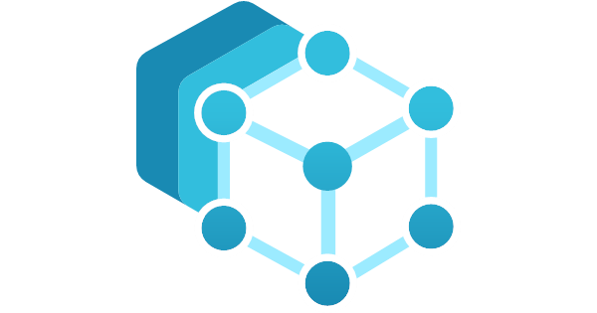
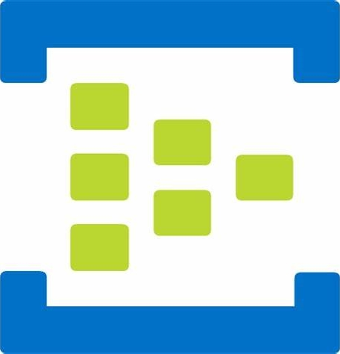

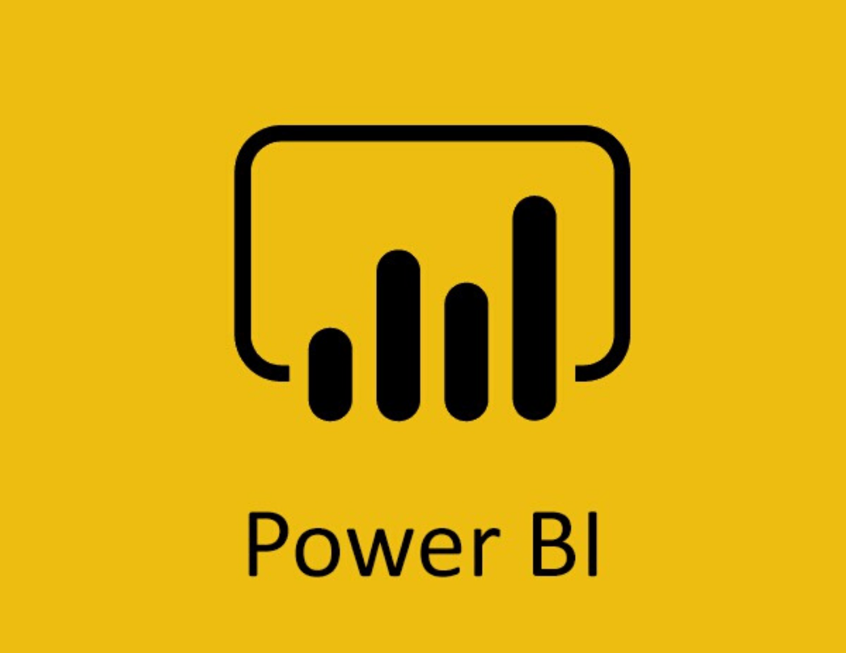

Control
(ISA-95 Level 2)
Operations management
(ISA-95 Level 3)
Edge
(with internet access)
Edge management
Data acquisition/brokering
Data analytics/storage
API
Applications
Two production lines in two locations
(simulated on a Windows VM)
Management
MES
Azure Arc
Management
Azure IoT
Operations
Edge gateway
MQ
Dataflows
Queries
OPC UA connector
UA-CloudAction
Azure Event Hubs
Message broker
Azure Data Explorer
time-series database
Microsoft Power BI
Schema registry
Queries
OPC UA-enabled assets
Azure IoT Operations
Client/Server
Kubernetes
Non-OPC UA assets
Any
interface
Web of Things
connectivity
solution
Linux
Firewall

