Slide 1
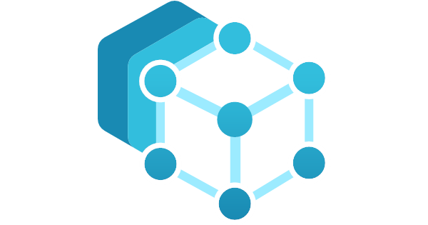
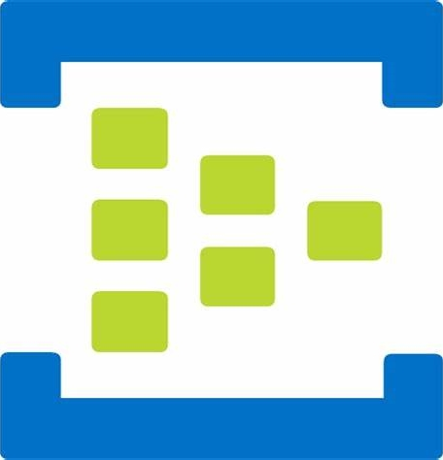


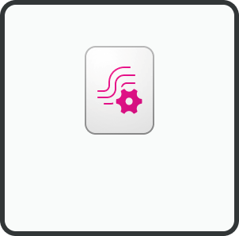
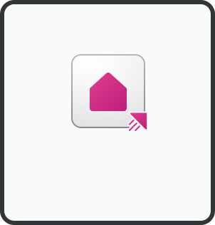

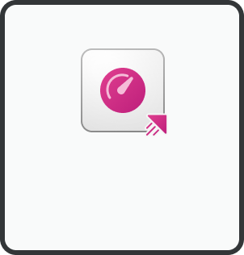

Control
(ISA-95 Level 2)
Operations management
(ISA-95 Level 3)
Edge
(with internet access)
Edge management
Data acquisition/brokering
Data analytics/storage
API
Apps
Two production lines in two locations
(simulated on a Windows VM)
Management
MES
Azure Arc
Management
Azure IoT
Operations
Edge gateway
MQ
Dataflows
OPC UA connector
UA-CloudAction
Azure Event Hubs
Kafka Message broker
Queries
Schema registry
OPC UA-enabled assets
Optional
alternative
Azure IoT Operations
Queries
Queries
Client/Server
I3X4Kusto
Custom app
Kubernetes
Queries
Non-OPC UA assets
Eventstream
Eventhouse
Power BI
Any
interface
Web of Things
connectivity
solution
Linux
OneLake
Dashboard
Firewall
ML models
Microsoft Fabric

