Slide 1
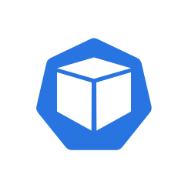
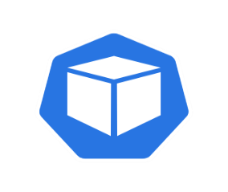
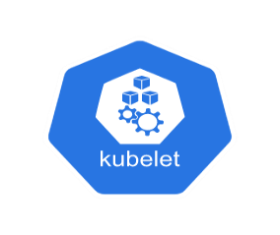
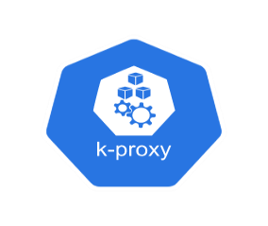
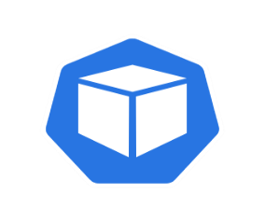
File storage
Azure Container Registry
Deployment system
Subnet
Azure Kubernetes Service
Web graphical user interface
Cluster nodes
Kubernetes system node
Kubernetes management pod
minds.ai Maestro management pod
App
Visualization
App
API server
REST API
Core
(DeepSim)
Tool
modeling
Scheduler
Scheduling
Controller manager
Application Programming Interfaces
Managed disk
App
License
management
App
etcd
Command-line interface
CPU node pool
GPU node pool
Pods
container
Kubelet
Kube-proxy
Pods
container
Kubelet
Kube-proxy
CPU spot pool
GPU spot pool
Pods
container
Kubelet
Kube-proxy
Pods
container
Kubelet
Kube-proxy
Virtual Network

