Slide 1

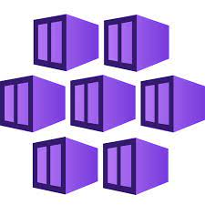


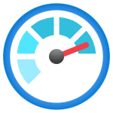

Machine-learning teams
Development
Deployment
Azure Databricks
Track experiments and register models
Azure Kubernetes Service
Azure API Management
External teams
Source data
Deploy container
Call API
Azure Data Lake Gen2
Machine Learning flow tracking server
Azure Container Registry
Azure Application Gateway
External
application
Containerize model
Collect metrics and logs
Platform
Microsoft Entra ID
Azure Cost Management
Azure
Key Vault
Microsoft Defender for Cloud
Azure Monitor
Azure DevOps and GitHub

Slide 2
Develop
Build
Deploy
Monitor
Staging
Production
Trigger on push or pull request
Manual
approval
check
Azure Databricks
GitHub Actions
GitHub Actions
GitHub Actions
Azure Monitor
GitHub repositories
Azure Container Registry
Azure Log Analytics workspace
Azure Kubernetes Service
Azure Kubernetes Service
Use metrics and logs to determine when model retraining needs to occur.

