Slide 1

PROBLEM
Confidential computing
Run agreed-upon analytics on the combined, sensitive dataset.
Gain insights without
giving access.
Meet confidentiality requirements.
Money laundering
Outcomes
Increase detection rates.
Learn iteratively.
Maintain privacy.
Bank 1
K₁
Bank 5
Bank 2
Machine learning
running in enclave
K₅
K₂
K₄
K₃
Bank 4
Bank 3
SOLUTION
Create a complete picture of fund movement.
Detect fraudulent patterns
(otherwise impossible with a single bank’s dataset)
Notes:
We started a journey towards the confidential computing vision in 2015 and we released the initial version of Always Encrypted.
Always Encrypted (it’s original version) is a client-side encryption technology: the data gets encrypted on the client side (within the client driver) before being stored in the database. The data is never decrypted inside the database. This provides strong data protection, but computations on protected data is restricted to just one operation – equality comparison, which is supported via deterministic encryption only.
The bank leverages this in Production workloads today with Azure SQL.

Slide 2






Q: How do you guarantee data security in this environment?
ROOM
A room located at one of the sites
Security access by card reader
PEOPLE
Independent consultants to analyze companies
Lawyers representation
Security guard
TECH
Server and VPN access only accessible within room
Printer and shredder to prevent data leak
Physical clean room
Virtual clean room
Business logic
Consultant 1
Consultant 2
Consultant 3
Analytical queries
Data flow
Platform management
Insight
Lawyer 1
Lawyer 2
Key management
Communication
protocol
ML framework
Access Card
Server
VPN
Printer
✂
Shredder
Data loader
Encrypted
Q: How do you guarantee data security in this environment?
A: Enclave technology (that is,
Azure confidential computing)
Security guard
Notes:
We started a journey towards the confidential computing vision in 2015 and we released the initial version of Always Encrypted.
Always Encrypted (it’s original version) is a client-side encryption technology: the data gets encrypted on the client side (within the client driver) before being stored in the database. The data is never decrypted inside the database. This provides strong data protection, but computations on protected data is restricted to just one operation – equality comparison, which is supported via deterministic encryption only.
The bank leverages this in Production workloads today with Azure SQL.

Slide 3

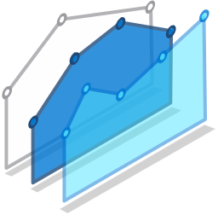
















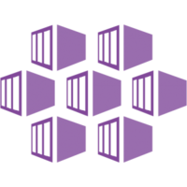



Big data storage
Big data analytics
Database engine
Key vault
Key vault
Node: SGX-enabled
Read
Column master key
mHSM
Storage account
Spark driver
Azure SQL
spark.read.parquet(…)
spark.read.format(“jdbc”)
Parquet
50 GB | 1.5 B rows
1
Executors
2
Plaintext
MSSQL
NYC taxi dataset
SGX-enclave
Kubernetes cluster
Contoso HR
dataset
Azure attestation
Token
Notes:
Raki

