Slide 1



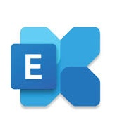
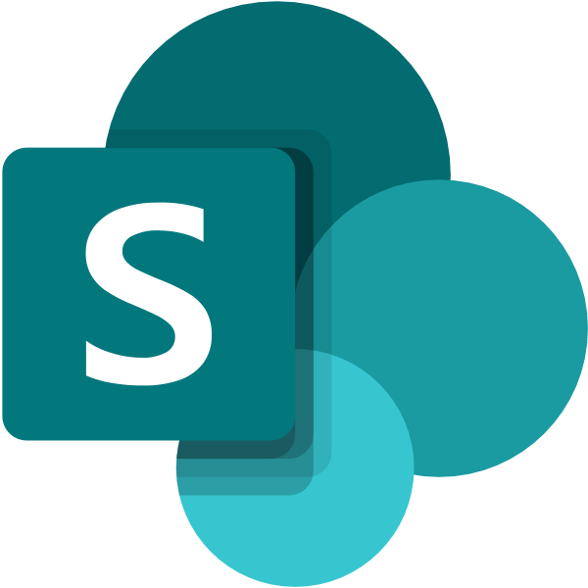

If you answer ‘Yes’ to any of these questions, that condition determines the architecture choice immediately. You must answer ‘No’ to all questions before
Microsoft’s Cloud Adoption Framework
Sovereignty in the Microsoft Sovereign Cloud- Decision tree
New requirement
Need to define your sovereignty requirements and controls?
Yes
Sovereignty planning
Learn how to define drivers and controls.
(aka.ms/cafsovplan)
No
Sovereignty deployment model selection: Default to the Sovereign Public Cloud. Only use Sovereign Private Cloud or a National Partner Cloud when a documented requirement cannot be satisfied in the Sovereign Public Cloud.
Can the workload's sovereignty requirements be met using Azure Public Cloud sovereignty controls? It has controls for data residency, data confidentiality (at rest, in transit, in use), key control, and operator access and auditing.
+
Yes
Sovereign Public Cloud
Azure Public Cloud with sovereignty controls
No
Does the workload have a mandatory requirement for customer-operated infrastructure or local operations?
Workload can have continuous Azure connectivity?
+
Yes
Yes
Sovereign Private Cloud Connected
Azure Local on premises with connectivity to Azure
No
No
You can also run GitHub, Foundry, Microsoft 365 locally
Sovereign Private Cloud Disconnected
Azure Local on premises with no Azure connectivity
Do legal or regulatory requirements mandate that cloud infrastructure be operated under national jurisdiction and independently of Microsoft?
Yes
National Partner Cloud
Infrastructure managed independent of Microsoft
No
Before onboarding workloads: Define sovereignty architecture, governance, and operational standards.
+
Need to define sovereign architecture patterns to meet requirements and apply governance baselines?
Yes
Sovereignty architecture & governance
Accelerator or custom build to apply governance baselines
(aka.ms/cafsovarch)
No
Need approved operational standards that keeps sovereignty compliant over time?
+
Yes
Sovereignty operational standards
Compliance monitoring and alignment across all workloads (aka.ms/cafsovops)
No
Onboard workloads
Deploy workloads across the appropriate mix of Microsoft Sovereign Cloud options
aka.ms/cafsov

Slide 2
Microsoft’s Cloud Adoption Framework
Deployment options in the Microsoft Sovereign Cloud
Sovereignty controls
National Partner Cloud
Sovereignty outside of Microsoft's public cloud
Sovereign Public Cloud
Sovereignty in Microsoft’s public cloud
Sovereign Private Cloud
Full infrastructure and operator sovereignty on premises
Partner controlled infrastructure
Azure Public Cloud
On-premises
Workloads on partner infrastructure
Azure workloads on Microsoft infrastructure
Workloads on Azure Local hardware
Partner provided services
Azure public cloud services
Microsoft 365, GitHub and Foundry AI available locally
aka.ms/cafsov

Slide 3



Microsoft’s Cloud Adoption Framework
Deployment options in the Microsoft Sovereign Cloud
Conceptual architecture
Sovereignty controls
Sovereign Public Cloud
Sovereignty in Microsoft’s public cloud
Microsoft Agent 365
Control agents
Microsoft Defender
Unified security
Microsoft Entra
Unified identity
Microsoft Purview
Unified data governance
Azure landing zone
Sovereign workloads in an Azure landing zone
Azure Public Cloud
National Partner Cloud
Sovereignty outside of Microsoft's public cloud
Sovereign Private Cloud
Full infrastructure and operator sovereignty on premises
Platform landing zone
Governance and centralized resources for application landing zones.
Partner controlled infrastructure
Partner provided services
On-premises
Application landing zones
Application landing zone
Azure workload
Application landing zone
Sovereign public cloud workload
Application landing zone
Sovereign private cloud workload
Workloads on Azure Local hardware
Workloads on partner infrastructure
Microsoft 365, GitHub and Foundry locally
Microsoft Foundry
Add Foundry to the workloads that need AI.
Foundry IQ
aka.ms/cafsov

Slide 4



Microsoft’s Cloud Adoption Framework
Deployment options in the Microsoft Sovereign Cloud
Conceptual architecture
Sovereignty controls
Sovereign Public Cloud
Sovereignty in Microsoft’s public cloud
Microsoft Agent 365
Control agents
Microsoft Defender
Unified security
Microsoft Entra
Unified identity
Microsoft Purview
Unified data governance
Azure landing zone
Sovereign workloads in an Azure landing zone
Azure Public Cloud
National Partner Cloud
Sovereignty outside of Microsoft's public cloud
Sovereign Private Cloud
Full infrastructure and operator sovereignty on premises
Platform landing zone
Governance and centralized resources for application landing zones.
Partner controlled infrastructure
Partner provided services
On-premises
Application landing zones
Application landing zone
Azure workload
Application landing zone
Sovereign public cloud workload
Application landing zone
Sovereign private cloud workload
Workloads on Azure Local hardware
Workloads on partner infrastructure
Microsoft 365, GitHub and Foundry locally
Microsoft Foundry
Add Foundry to the workloads that need AI.
Foundry IQ
Microsoft business, data, and AI solutions integrate with Azure and each other.
Microsoft business, data, and AI solutions
SaaS AI platform
SaaS data and analytics platform
Microsoft Copilot Studio
Microsoft Fabric
Microsoft 365
Microsoft 365 Copilot
AI for work
Agents and workflows
Fabric IQ
Work IQ
Data sources can be integrated, governed, and secured across Azure and Microsoft platforms.
Data sources
On-premises
Dataverse
Microsoft 365
Azure workloads
Other clouds
aka.ms/cafsov

Slide 5

Microsoft’s Cloud Adoption Framework
Deployment options in the Microsoft Sovereign Cloud
Detailed conceptual architecture
Sovereignty controls
Sovereign Public Cloud
Sovereignty in Microsoft’s public cloud
Microsoft Agent 365
Control agents
Microsoft Defender
Unified security
Microsoft Entra
Unified identity
Microsoft Purview
Unified data governance
National Partner Cloud
Sovereignty outside of Microsoft's public cloud
Azure landing zone
Sovereign workloads in an Azure landing zone
Sovereign Private Cloud
Full infrastructure and operator sovereignty on premises
Azure Public Cloud
One or more Azure subscriptions
Partner controlled infrastructure
Partner provided services
Platform landing zone
On-premises
Platform personnel manage the platform landing zone.
Tenant root group
Management groups
Azure Policy
Azure RBAC
Intermediate root
Azure Local connected hardware
Workloads on partner infrastructure
Platform
Landing zones
Decommissioned
Sandbox
Azure Local disconnected hardware
Security
Management
Identity
Connectivity
Internal (“Corp”)
Online
Local
Application landing zone
Managed on-premises
Environment (production)
Distribution and placement of application landing zone subscriptions under the right management group
Platform subscriptions for centralized resources
Environment (test)
Platform landing zone: One per Microsoft Entra tenant. Provides centralized governance and shared resources
Environment (development)
Workload personnel manage
application landing zones.
Application landing zones
Example INTERNAL workloads
Example ONLINE workload
Example LOCAL workload
Microsoft 365, GitHub and Foundry locally
Application landing zone
Fabric compute
Application landing zone
Sovereign public cloud workload
(All workload environments)
Application landing zone
Sovereign public cloud workload
(All workload environments)
Application landing zone
Sovereign private cloud workload -
Connected
Managed via Azure public cloud
Environment (Fabric capacity)
Environment (production)
Environment (production)
Environment (test)
Environment (test)
Environment (production)
Application landing zone
Example Data, AI/ML workload
Azure Machine Learning, Azure Databricks, AI on Azure Infra.
Environment (development)
Environment (development)
Environment (production)
Application landing zone
Sovereign private cloud workload - Disconnected
Add a Foundry resource to the environments where you need PaaS AI.
Billing purposes only
Microsoft Foundry
Foundry IQ
Application landing zones: Each workload has one application landing zone consisting of all environments. Each environment consists of one or more Azure subscriptions.
aka.ms/cafsov

Slide 6
Microsoft’s Cloud Adoption Framework
Deployment options in the Microsoft Sovereign Cloud
Detailed conceptual architecture
Sovereignty controls
Sovereign Public Cloud
Sovereignty in Microsoft’s public cloud
Microsoft Agent 365
Control agents
Microsoft Defender
Unified security
Microsoft Entra
Unified identity
Microsoft Purview
Unified data governance
National Partner Cloud
Sovereignty outside of Microsoft's public cloud
Azure landing zone
Sovereign workloads in an Azure landing zone
Sovereign Private Cloud
Full infrastructure and operator sovereignty on premises
Azure Public Cloud
One or more Azure subscriptions
Partner controlled infrastructure
Partner provided services
Platform landing zone
On-premises
Platform personnel manage the platform landing zone.
Tenant root group
Management groups
Azure Policy
Azure RBAC
Intermediate root
Azure Local connected hardware
Workloads on partner infrastructure
Platform
Landing zones
Decommissioned
Sandbox
Azure Local disconnected hardware
Security
Management
Identity
Connectivity
Internal (“Corp”)
Online
Local
Application landing zone
Managed on-premises
Environment (production)
Distribution and placement of application landing zone subscriptions under the right management group
Platform subscriptions for centralized resources
Environment (test)
Platform landing zone: One per Microsoft Entra tenant. Provides centralized governance and shared resources
Environment (development)
Workload personnel manage
application landing zones.
Application landing zones
Example INTERNAL workloads
Example ONLINE workload
Example LOCAL workload
Microsoft 365, GitHub and Foundry locally
Application landing zone
Fabric compute
Application landing zone
Sovereign public cloud workload
(All workload environments)
Application landing zone
Sovereign public cloud workload
(All workload environments)
Application landing zone
Sovereign private cloud workload -
Connected
Managed via Azure public cloud
Environment (Fabric capacity)
Environment (production)
Environment (production)
Environment (test)
Environment (test)
Environment (production)
Application landing zone
Example Data, AI/ML workload
Azure Machine Learning, Azure Databricks, AI on Azure Infra.
Environment (development)
Environment (development)
Environment (production)
Application landing zone
Sovereign private cloud workload - Disconnected
Add a Foundry resource to the environments where you need PaaS AI.
Billing purposes only
Microsoft Foundry
Foundry IQ
Application landing zones: Each workload has one application landing zone consisting of all environments. Each environment consists of one or more Azure subscriptions.
Microsoft business, data, and AI solutions integrate with Azure and each other.
Microsoft business, data, and AI solutions
SaaS AI platform
SaaS data and analytics platform
Microsoft Copilot Studio
Microsoft Fabric
Microsoft 365
Microsoft 365 Copilot
AI for work
Agents and workflows
Fabric IQ
Work IQ
Data sources can be integrated, governed, and secured across Azure and Microsoft platforms.
Data sources
On-premises
Dataverse
Microsoft 365
Azure workloads
Other clouds
aka.ms/cafsov

Slide 7
1. Planning and organizational readiness
2. Architecture and governance
3. Operational standards

