Slide 1
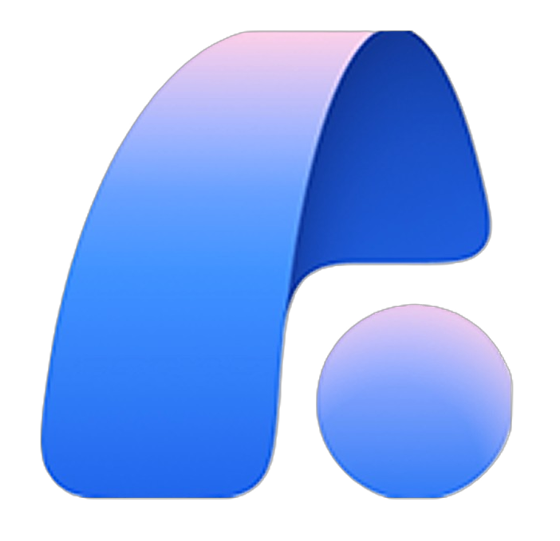



Microsoft’s Cloud Adoption Framework
Azure VMware Solution in an Azure landing zone
Conceptual architecture
Azure VMware Solution
Unified identity, security, and governance
Microsoft Agent 365
Microsoft Defender
Microsoft Entra
Microsoft Purview
Control agents
Unified security
Unified identity
Govern all data
Azure landing zone
Azure
Platform landing zone
Governance and centralized resources for all Azure workloads.
Application landing zones
Application landing zone
Azure workload
Application landing zone
Azure VMware Solution workload
Application landing zone
Azure workload
Microsoft Foundry
Add Foundry to the workloads that need AI.
Foundry IQ

Slide 2
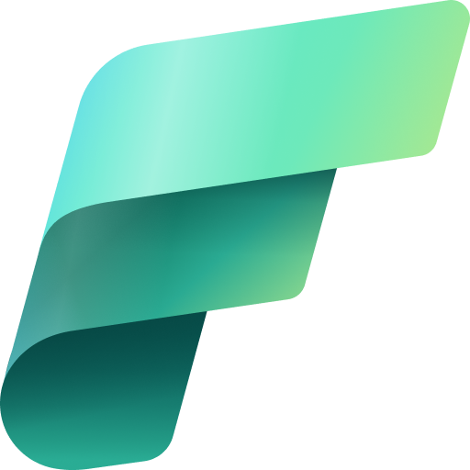


Microsoft’s Cloud Adoption Framework
Azure VMware Solution in an Azure landing zone
Conceptual architecture + Enterprise integration
Azure VMware Solution
Unified identity, security, and governance
Microsoft Agent 365
Microsoft Defender
Microsoft Entra
Microsoft Purview
Control agents
Unified security
Unified identity
Govern all data
Azure landing zone
Azure
Platform landing zone
Governance and centralized resources for application landing zones.
Application landing zones
Application landing zone Azure workload
Application landing zone
Azure VMware Solution workload
Application landing zone
Azure workload
Microsoft Foundry
Add Foundry to the workloads that need AI.
Foundry IQ
Microsoft business, data, and AI solutions integrate with Azure and each other.
Microsoft business, data, and AI solutions
SaaS AI platform
SaaS data and analytics platform
Microsoft Copilot Studio
Microsoft Fabric
Microsoft 365
Agents and workflows
Fabric IQ
Microsoft 365 Copilot
AI for work
Work IQ
Data sources can be integrated, governed, and secured across Azure and Microsoft platforms.
Data sources
On-premises
Dataverse
Microsoft 365
Azure workloads
Other clouds

Slide 3
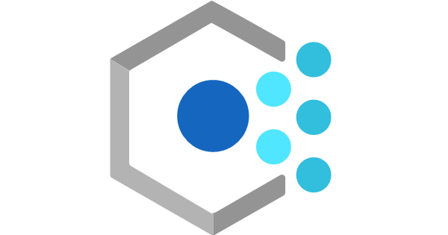
Microsoft’s Cloud Adoption Framework
Azure VMware Solution in an Azure landing zone
Detailed conceptual architecture
Azure VMware Solution
Unified identity, security, and governance
Microsoft Agent 365
Microsoft Defender
Microsoft Entra
Microsoft Purview
Control agents
Unified security
Unified identity
Govern all data
Azure landing zone
Azure
One or more Azure subscriptions
Platform personnel manage the platform landing zone.
Platform landing zone
Tenant root group
Management groups
Azure Policy
Azure RBAC
Intermediate root
Platform
For application landing zones
Landing zones
Decommissioned
Sandbox
Security
Management
Identity
Connectivity
Internal (“Corp”)
Online
Local
Distribution and placement of application landing zone subscriptions under the right management group
Platform subscriptions for centralized resources
Platform landing zone: One per Microsoft Entra tenant. Provides centralized governance and shared resources
Workload personnel manage
application landing zones.
Application landing zones
Example INTERNAL workloads
Example ONLINE workload
Example LOCAL workload
Application landing zone
Fabric compute
Application landing zone
Azure VMware Solution workload
Application landing zone
Azure VMware Solution workload
Application landing zone
Azure workload
zones
Environment (production)
Environment (production)
Environment (production)
zones
Environment (Fabric capacity)
Environment (test)
Environment (test)
Environment (test)
Application landing zone
Example Data, AI/ML workload
Environment (development)
Environment (development)
Environment (development)
(All workload environments)
(All workload environments)
(All workload environments)
zones
zones
Environment (production)
Azure Machine Learning, Azure Databricks, AI on Azure Infrastructure, Azure Data Lake Storage
Microsoft Foundry
Add a Foundry resource to the environments where you need PaaS AI.
Foundry IQ
Application landing zones: Each workload has one application landing zone consisting of all environments. Each environment consists of one or more Azure subscriptions.

Slide 4
Microsoft’s Cloud Adoption Framework
Azure VMware Solution in an Azure landing zone
Detailed conceptual architecture
Azure VMware Solution
Unified identity, security, and governance
Microsoft Agent 365
Microsoft Defender
Microsoft Entra
Microsoft Purview
Control agents
Unified security
Unified identity
Govern all data
Azure landing zone
Azure
One or more Azure subscriptions
Platform personnel manage the platform landing zone.
Platform landing zone
Tenant root group
Management groups
Azure Policy
Azure RBAC
Intermediate root
Platform
For application landing zones
Landing zones
Decommissioned
Sandbox
Security
Management
Identity
Connectivity
Internal (“Corp”)
Online
Local
Distribution and placement of application landing zone subscriptions under the right management group
Platform subscriptions for centralized resources
Platform landing zone: One per Microsoft Entra tenant. Provides centralized governance and shared resources
Workload personnel manage
application landing zones.
Application landing zones
Example INTERNAL workloads
Example ONLINE workload
Example LOCAL workload
Application landing zone
Fabric compute
Application landing zone
Azure VMware Solution workload
Application landing zone
Azure VMware Solution workload
Application landing zone
Azure workload
zones
Environment (production)
Environment (production)
Environment (production)
zones
Environment (Fabric capacity)
Environment (test)
Environment (test)
Environment (test)
Application landing zone
Example Data, AI/ML workload
Environment (development)
Environment (development)
Environment (development)
(All workload environments)
(All workload environments)
(All workload environments)
zones
zones
Environment (production)
Azure Machine Learning, Azure Databricks, AI on Azure Infrastructure, Azure Data Lake Storage
Microsoft Foundry
Add a Foundry resource to the environments where you need PaaS AI.
Foundry IQ
Application landing zones: Each workload has one application landing zone consisting of all environments. Each environment consists of one or more Azure subscriptions.
Microsoft 365, Microsoft Fabric, and Copilot Studio can integrate with Azure and each other to share data, AI capabilities, and business context.
Microsoft business, data, and AI solutions
SaaS AI platform
SaaS data and analytics platform
Microsoft Copilot Studio
Microsoft Fabric
Microsoft 365
Agents and workflows
Fabric IQ
Microsoft 365 Copilot
AI for work
Work IQ
Enterprise data from any source can be integrated, governed, secured, and used across Azure and Microsoft services.
Data sources
On-premises
Dataverse
Microsoft 365
Azure workloads
Other clouds

Slide 5
Azure VMware Solution adoption guidance for decision makers
1. Planning and readiness
2. Azure landing
zone architecture
3. Governance and security baselines
4. Operational standards
5. Migration

