Slide 1

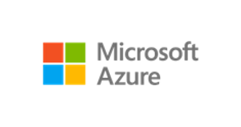
Azure Virtual Desktop on Azure Local reference architecture
Control plane The Azure portal, Azure Resource Management template and Bicep templates, the Azure CLI and tools
Microsoft
Entra ID
User authentication and token exchange during login
Azure Virtual Desktop
Azure Site Recovery
Azure Backup
Azure File Sync
Azure Update Manager
Other Azure services integration via Azure Arc
Azure Policy
Azure Monitor
Azure Key Vault
Microsoft Defender for Cloud
2
Hybrid identity sync between on-premises AD DS and cloud-based Microsoft Entra ID for local authentication and cloud access
3
Session initiation to Azure Virtual Desktop in Azure from user’s device
User devices
4
1
Azure Virtual Desktop client
Azure Virtual Desktop agent connects to Azure and handles session brokering, user sessions, metering, and diagnostics
Active Directory Domain Services (AD DS)
Azure Arc agent integration for extra governance, monitoring, and life cycle management
RDP Shortpath (with VPN) or Direct UDP connection
User credential validation, group policy application
Azure Local VMs
Azure Virtual Desktop (session hosts)
User profile storage location:
Dedicated NAS or SMB file share storage (preferred option) or
S2D pool on Azure Local instance
Azure Virtual Desktop agent
Azure Arc agent
Azure Local instance
5
Network attached storage or SMB file share
Azure Local version releases
User profiles
Hyper-V
Azure Arc
resource bridge
Storage Spaces Direct (S2D)
User profiles

