Slide 1
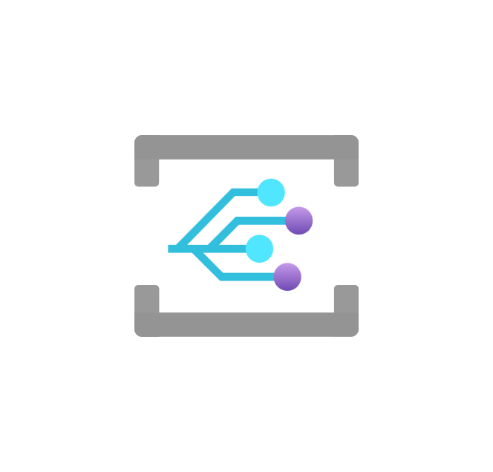
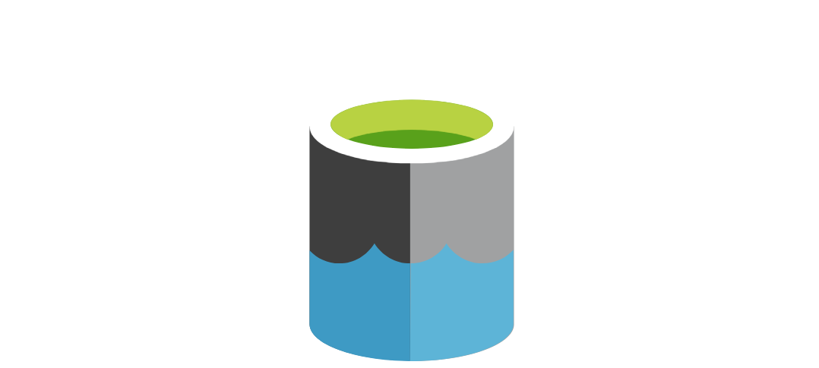
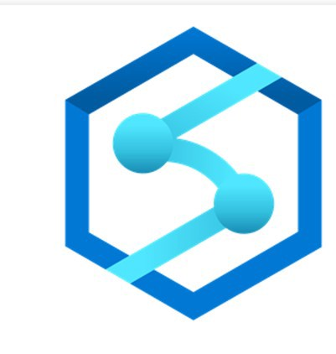
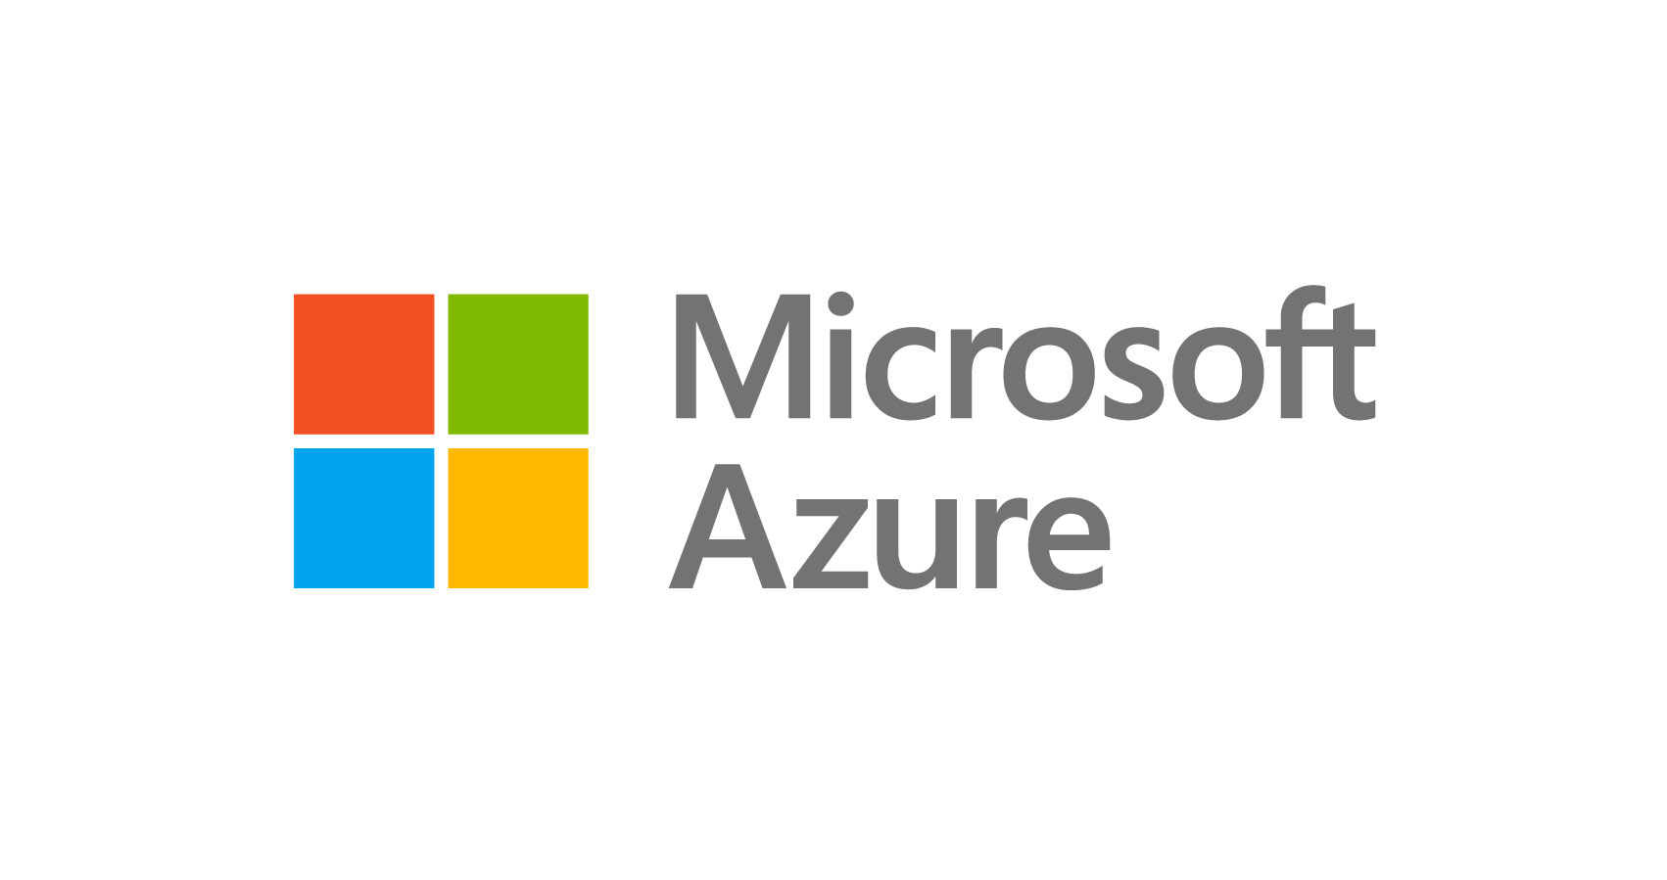
Document data model
Distributed systems architecture
Cloud | On-premises
1
Metadata of the change
MongoDB Atlas on Azure as source
3a
2
Custom trigger
6
BI tools
Change stream API
Event publisher
Storage
trigger
3b
Azure Synapse Analytics pipeline
SQL pools/
Spark pools
Delta data
6
Atlas as sink
Real-time apps
5
4
Synapse Studio

Slide 2
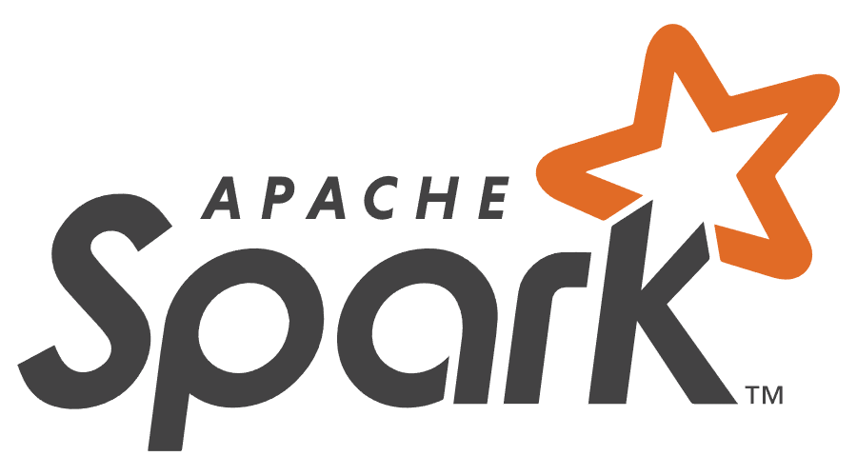
RDBMS
(tabular)
Enterprise data warehouse
Consumers
Document data model
Distributed systems architecture
Cloud | On-premises
1
MongoDB Atlas on Azure
Consuming operational
apps and services
Machine learning
Internal apps, customer-facing services, and APIs for third-party consumption – across any channel
Big data analytics
MongoDB source connector
SQL
MongoDB
sink connector
MongoDB analytics
store
BI dashboard
Operational data
layer
Azure Synapse Analytics
Logs
(unstructured)

Slide 3
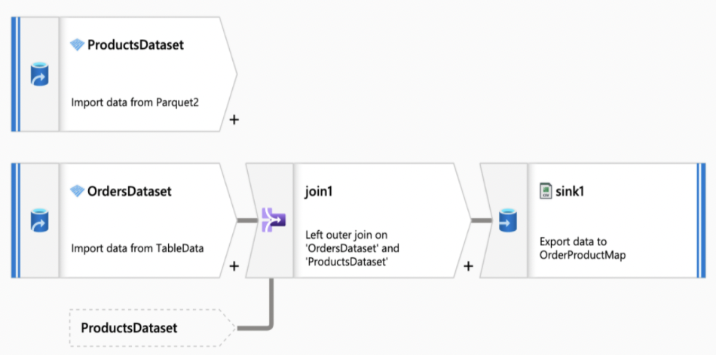
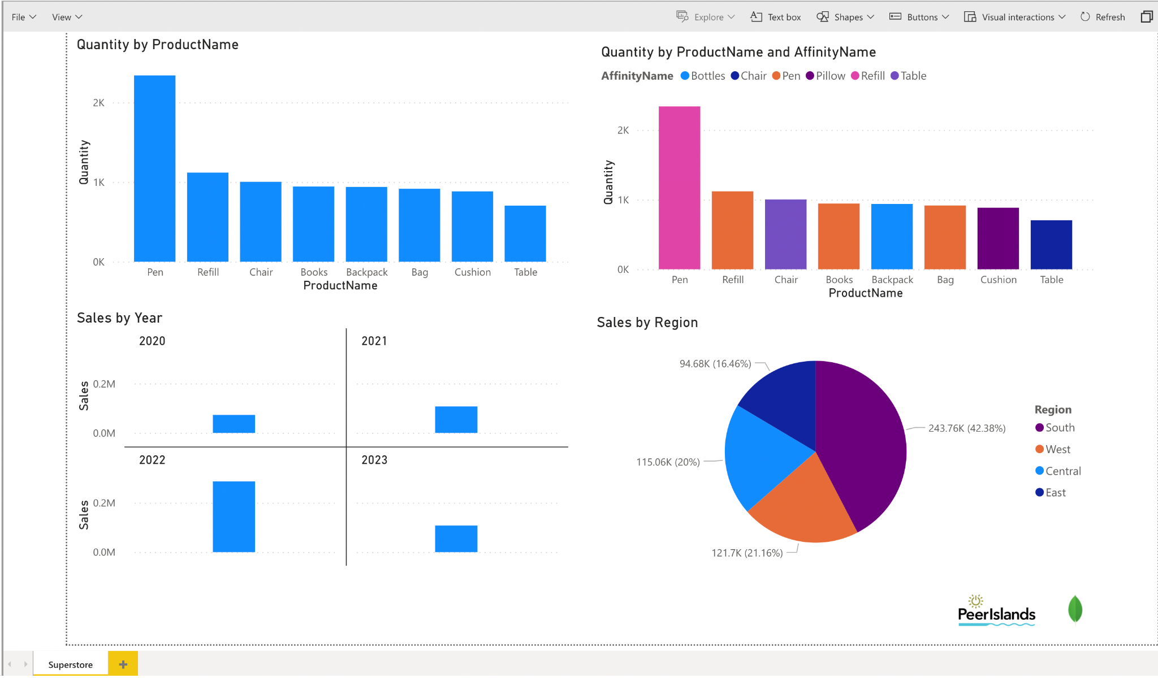
Azure Synapse - pipeline
Power BI analytics / dashboard

Slide 4
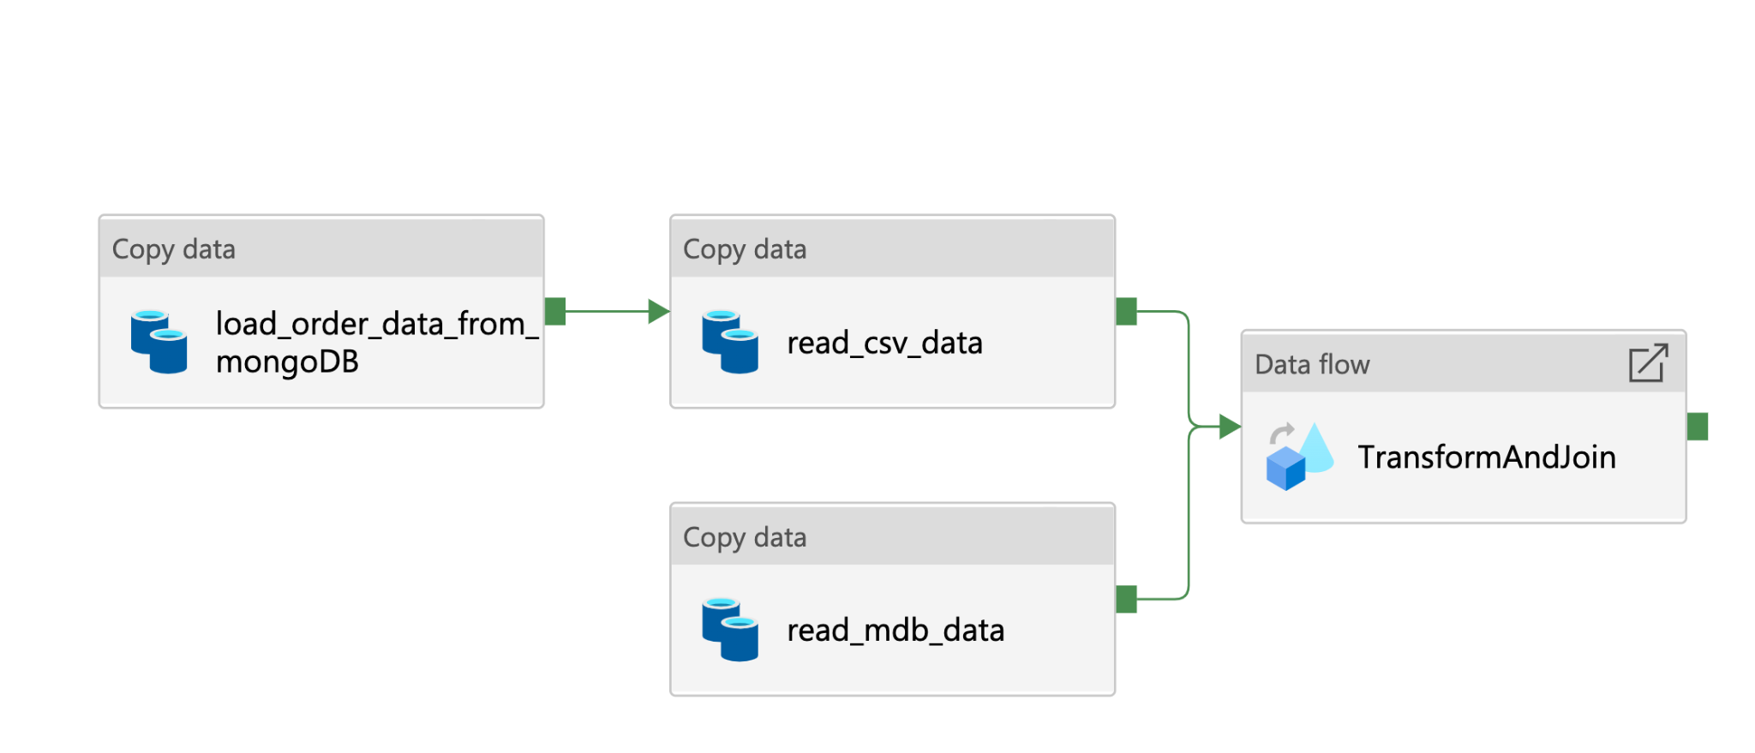
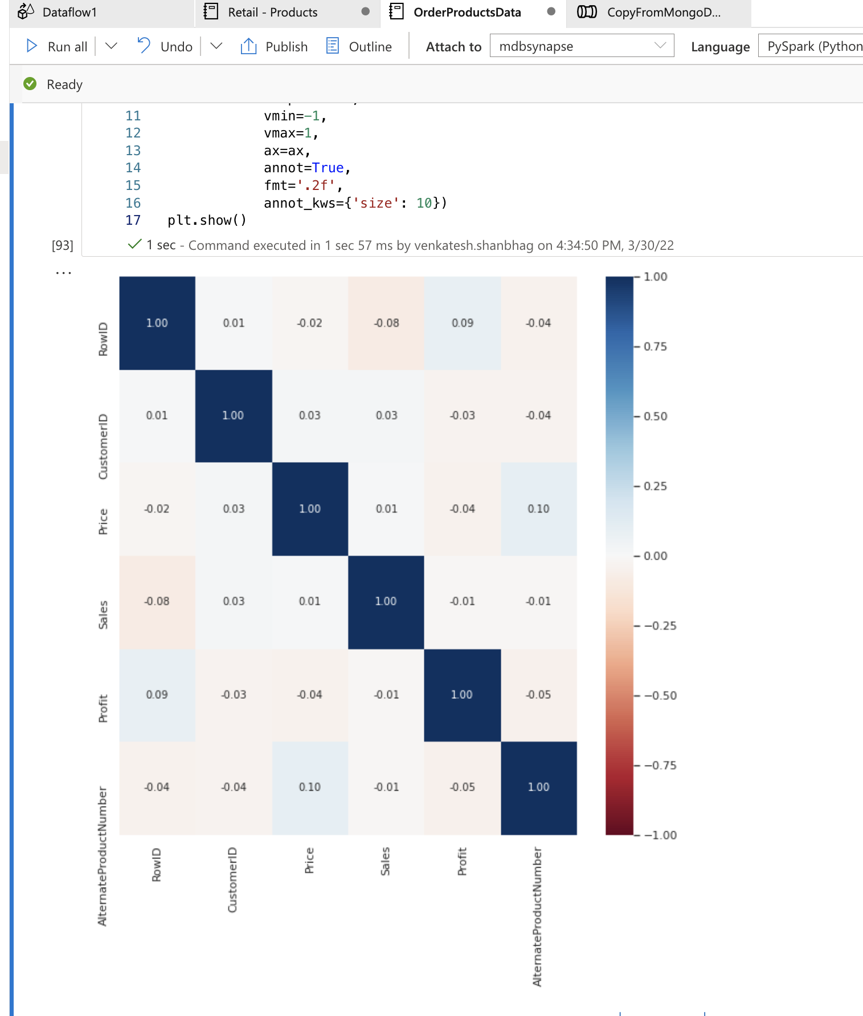
Azure Synapse - pipeline
PyCharm workflow

