Slide 1




Your content
Azure Cognitive Search
Your app
Full indexing
Query requests
Indexing
engine
Indexes and other structures
Query
engine
Collects user input
Formulates and sends requests
Handles responses
a result set
a single document
. . .
Refresh indexing
(in the cloud or behind a firewall)
AI enrichment
Query responses

Slide 2






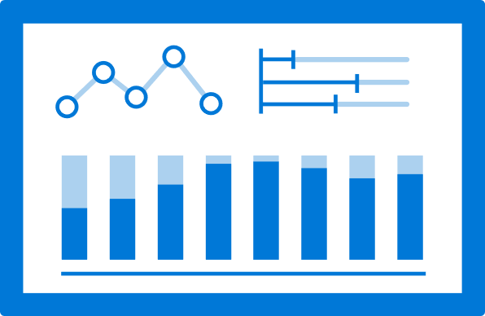








Compliance analyst app
OCR, translate, extract entities
Identify business risks
Cognitive Search solution
Knowledge store
. . .
Communication channels

Slide 3














Ingest source data
AI enrichments
Search solution
Compliance analyst UI
Scoring profiles
Semantic search
Query engine
Review risks
and content,
cross channel research
Query
Azure Blob Storage
Azure Cognitive Services
Custom models
Azure Cognitive Search
MS Graph
Data Connect
JSON / EML / MSG
Metadata (to, date, …)
Message body
Attachments
Language, computer vision
Risk detection
Indexed and enriched documents
Original type | Email, call, news
Email metadata | To / from / cc
Call metadata | Participants, duration
Content | Body, transcription, document content
Cognitive Services enrichments | People, organizations etc.
Risk model results | Risk scores, identified risk phrases
(keep unchanged)
OCR for attachments, translate, extract entities | Extract signals of collusion, market manipulation etc.
Search
Comms. details
Upload
Emails,
chats
Emails
Knowledge store
Speech2Text
JSON
Metadata (caller etc.)
Transcribed text
Archive,
retrieval
(keep unchanged)
Translate, extract entities | Extract signals of collusion, market manipulation etc.
Voice
Transcripts
Use by downstream systems
Data source
Word / PDF
Unstructured content incl. images
News, documents
OCR, translate, extract entities
Analytics,
machine learning
SharePoint
Microsoft Azure
Notes:
Changes

Slide 4


Business owner of the Risk Analysis solution
Secures funding, approval of scope and final solution
Stakeholder management with other departments
Training machine learning models for risk analysis
depends on the approach (Language Understanding approach vs sophisticated NLP-model)
Management sponsor
Data scientist
Specify the risks the solution should focus on
Acquire data for training the risk models
Creates the end user app resp. customizes the Knowledge Mining Solution Accelerator
.Net core web development skills
Risk mgmt. experts
Frontend developers
Users of the Risk Analysis solution
Test first prototypes and provide feedback
Automating the Azure Cognitive Search assets
Coding of custom skill interface for risk mgmt. models
Compliance analysts
Backend developers
Defines overall design and technical architecture
Azure Cognitive Search, Cognitive Services, Azure Functions, Language Understanding, and other services in scope
provide the required Azure infrastructure components
connectivity to existing systems (e.g., Office 365, telephony, downstream systems)
Search solution architect
IT infrastructure personnel
Notes:
Changes

Slide 5









Microsoft Graph Data Connect
Apply defined data controls
Securely extend Office 365 data to Azure
Enable big data and machine learning
Data at scale
Customer data
Granular consent
Product data
Security & governance
Industry data

Slide 6







Azure Active Directory
Get SAS token for Azure Blob Storage
Sign in
Authentication
Azure Key Vault
REST API
Azure API Management
RBAC
1
2
3
Upload audio files
Transcribe audio to text
Client application
Uploaded files
Data source
Transcribed files
Cognitive Search
Azure Event Grid trigger
Azure Functions
Azure Cognitive Services
Azure Blob Storage

Slide 7
Email data source
Email indexer
Transcript data source
Transcription indexer
Index
News data source
News indexer
Azure Blob Storage

Slide 8











Cognitive skill
Source data
Document cracking
Search index
Query requests
Skillset:
Extensible enrichment pipeline
Compliance app use case
Enriched documents
Projections
Retrieval
Analytics
Knowledge store
Machine learning
Human validation
Azure Data Factory
SQL
Database
Knowledge store use cases

Slide 9

Azure Cognitive Search REST API
build-search-config.py
1
email-datasource.json
4
Combined-index.json
5
email-indexer.json
8
email-skillset.json
2
news-datasource.json
6
news-indexer.json
9
news-skillset.json
3
transcript-datasource.json
7
transcript-indexer.json
10
transcript-skillset.json
Notes:
Changes

Slide 10
1
2
3
4
5
Emails
Optical character recognition
Language detection
Extract people and organizations
Translation
Custom models for risk detection
Transcriptions
Market news
Notes:
Changes

Slide 11
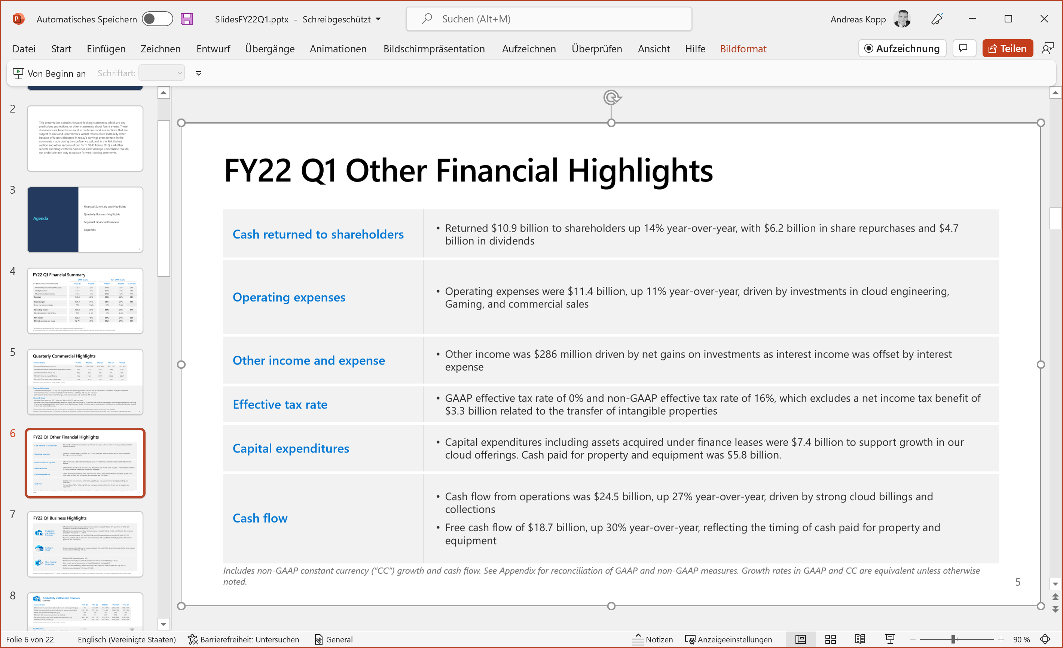

Quarterly Report
Slides contain only images
Notes:
Changes

Slide 12
Risk Communication
Dear Mary,
Thank you for reaching out and providing the market report. Regarding your ask about a potential investment. Internally, I have seen huge demand for treasury this morning. Happy to provide some special insights to you. Let’s take this conversation offline. Can we meet after work for a beer?
With regards to your further ask about general information …
Notes:
Changes

Slide 13


“ Happy to provide some special insights to you. Let’s take this conversation offline. ”
Basic preprocessing
Tokenize into sentences
Send sentences to LUIS
Aggregate responses
Azure Functions
Risk: Insider Information
Score: 0.89
LUIS apps
Aggregated results | Average risk score
Results for each risk model | Identified risk Risk score Top risk sentence Risk model version
Content
Document type
Query requests
Emails
Built-in skills
Custom skill
Enriched index
Compliance analyst
Transcriptions
Notes:
Changes

