Slide 1
Reference Architecture for Moodle on Azure (Single Region)
Azure region
Virtual network
Network security group
Azure Application Gateway
Students
Azure VPN gateway
Azure Database for MySQL
Azure Cache for Redis
Azure Virtual Machine Scale Sets
Delegated subnet
Customer datacenter
vol1
vol2
Snapshots
vol3
Azure NetApp Files
NFS volumes

Slide 2
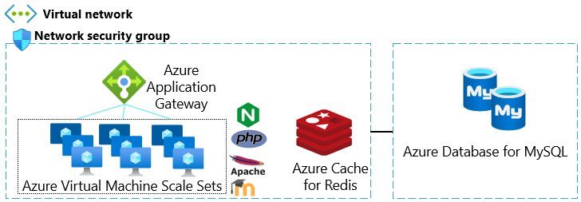
Reference - Highly Available Architecture for Moodle on Azure (Multi-Region)
Azure Traffic Manager
Students
Azure region A
Azure region B
Virtual network
Network security group
Azure Application Gateway
Azure VPN gateway
Azure Database for MySQL
Azure Cache for Redis
Azure Virtual Machine Scale Sets
Delegated subnet
Customer datacenter
vol1
vol1
vol2
Cross-region replication
vol2
vol3
vol3
Azure NetApp Files
NFS volumes
NFS DR volumes
*Public Preview Feature available between Azure paired regions only

