Slide 1
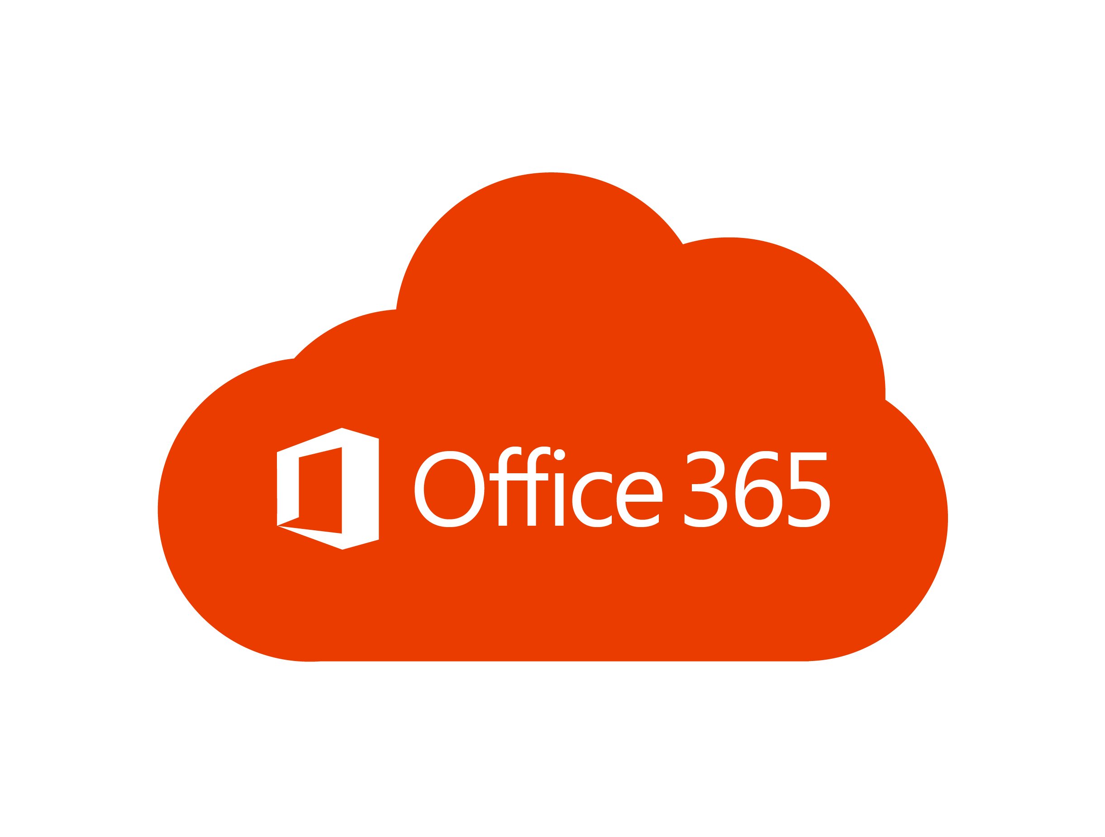
Polyglot
persistence
Storage / databases
Products microservice
Software as a service (SaaS)
Profile microservice
Data Lake
Application Gateway
Ingress Controller
https://api.contoso.com
HTTPS
HTTPS
Content microservice
Cosmos DB
Azure
Front Door
API
Management
HTTPS
Orders microservice
Azure SQL
Azure Kubernetes Service cluster
Payment microservice
Blob Storage
App config / caching
App
configuration

Slide 2
Define SLIs and SLOs before finalizing the design of the service
Identify the metric to monitor to ensure appropriate reliability
Define how to calculate the SLI for the metric
Set a target as the SLO to compare against during use
For example,
For example,
Service Availability
99 percent of the requests are successful when measured over a 24-hour time window
(Count of requests where
http_status_code != 500)
/ (Total number of requests)
Service availability

